Slide 1

Home Irrigation Control System (HICS)
Senior Design I
11-05-2014
Belachew Haile-Mariam(L)
Gautam Adhikari
Jeremiah O’Conner
Tung Vo
Notes:
This presentation demonstrates the new capabilities of PowerPoint and it is best viewed in Slide Show. These slides are designed to give you great ideas for the presentations you’ll create in PowerPoint 2010!
For more sample templates, click the File tab, and then on the New tab, click Sample Templates.

Slide 2
Product Concept
1
Home Irrigation Control System
Tung

Slide 3

Product Concept
What is the product?
An intelligent home irrigation system that collects soil moisture readings from in-ground sensors and analyzes the data to determine the necessary amount of water needed for the user’s lawn
What problem does it solve ?
This product will make home irrigation easier by providing customers with an automated watering solution that helps with water conservation, also it allows customers remote control their home irrigation via web application even though they are at home or not

Slide 4
Product Concept
Who is the intended audience?
Home owners that either have or plan on installing a sprinkler system.
The irrigation/landscaping companies that install those systems for their customers.
Audiences with water conservation in mind
Those who find themselves away from their homes for extended periods of time
What does is look like?
The product will look like a regular sprinkler timer that exist on the market now, and it will be able to connect to the Internet, so users can access and do remote control their irrigation system via web application

Slide 5
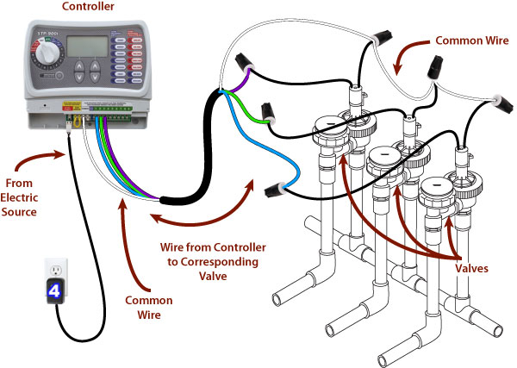
Product Concept
What does is look like?
Regular Home Irrigation System

Slide 6
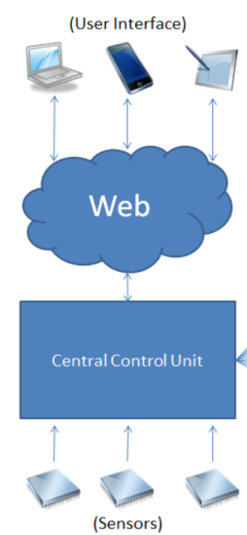
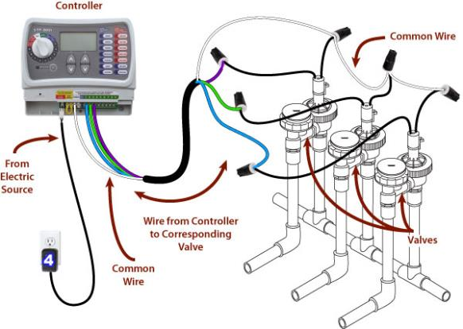
Product Concept
Existing Irrigation System
Smart Grass - Home Irrigation ControlSystem

Slide 7
Product Features and Functional Overview
2
Home Irrigation Control System
Tung

Slide 8
Product Features and Functional Overview
What does the product do?
1. Soil Moisture Reading: The sensors monitor soil moisture levels in the user’s lawn and sends that information to the central control unit
2. Web Services: HICS utilizes a web server to store all soil readings from the microcontroller, analyzed to determine what water amounts the lawn requires and allows the user to adjust the watering schedule accordingly

Slide 9
Product Features and Functional Overview
What does the product do?
3. Remote Control: A web application will provide control features to adjust watering schedules, read and record data collected by the moisture sensors, and turn the sprinkler valves on and off. This will allow the user to maintain complete control over their home irrigation system regardless of their physical location.
4. Scheduling: Users will be able to create and edit watering schedules for the HICS via its web application. The web server will provide its own suggested watering schedule that will be created based on soil moisture levels, and previous watering history.

Slide 10
Product Features and Functional Overview
What does the product do?
5. Local Weather Analysis : The user can set to override watering based on reports from an included rain sensor. HICS will not operate when it is raining at the systems location.
6. Web Application with Scalable Interface: The web application will be built with scalability in mind to enable the same functionality on a mobile device as it would on a desktop computer.

Slide 11
Product Features and Functional Overview
What does the product do?
7. Registration and Account Management: Each HICS controller will be given a unique serial number that will be used for registration purposes. Once the user creates an account and registers their device they will be granted full access to interface with their device via the web application

Slide 12
Product Features and Functional Overview
What are product’s restraints?
The product only performs controlling over an existing home irrigation via web application by collecting readings from sensors. It will not do in ground installation, which belongs to the irrigation company.

Slide 13
Required Inputs and Output
3
Home Irrigation Control System
Jeremiah

Slide 14
Product Concept
Existing Irrigation System
Smart Grass Home Irrigation Control System

Slide 15
Required Inputs and Outputs
Name | Data Flow | Description | Use
Soil Moisture Sensors | Output | The sensors send the soil moisture levels to the central control unit. | The moisture levels are used to determine the amount of water the lawn needs.
Rain Sensor | Output | The sensor sends an alert signal to the central control unit when it detects rain. | The rain sensor is used to alert the central control unit of rain so that the valves can be shut off to conserve water.
Central Control Unit | Input / Output | The central control unit relays data between the web server, sensors, and valves. | The unit sends the sensor readings to the web server and receives control commands to toggle the water valves.
Web Server | Input / Output | The server communicates with all devices and stores all information. | The server relays data between the application and central control unit.
Application – Create/Update Account | Input | The user will be able to create/modify an account associated with a device. | The user account is used to login and monitor/control a device.
Application – Create/Update Schedule | Input / Output | The watering schedules communicate with the web server to start/stop watering. | The watering schedules are used to determine when to water the lawn and for how long.
Application – Login | Input | The user must login with their registered username and password to access the application. | The user login is required to provide security for controlling a HICS device.
Application – Power | Input | The user inputs an action to immediate start or stop watering. | The water valve will toggle between open and closed to start or stop watering.
Application - Reports | Input / Output | The user inputs parameters to display specific data from the web server. | The user can generate reports to display information about current/past soil reading and watering schedules.

Slide 16
User Interface
4
Home Irrigation Control System
Tung

Slide 17
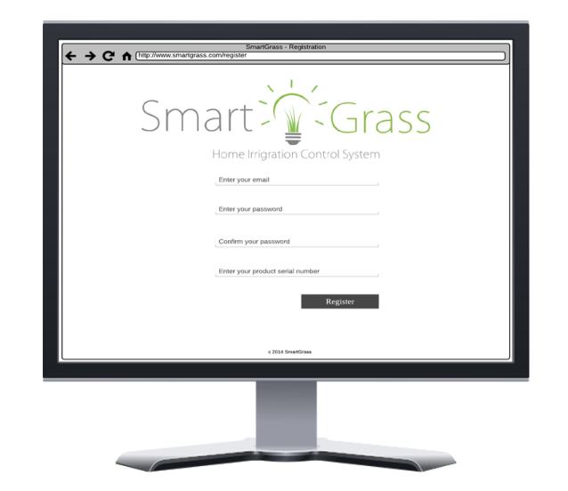
User Interface Requirements
User Registration Interface

Slide 18
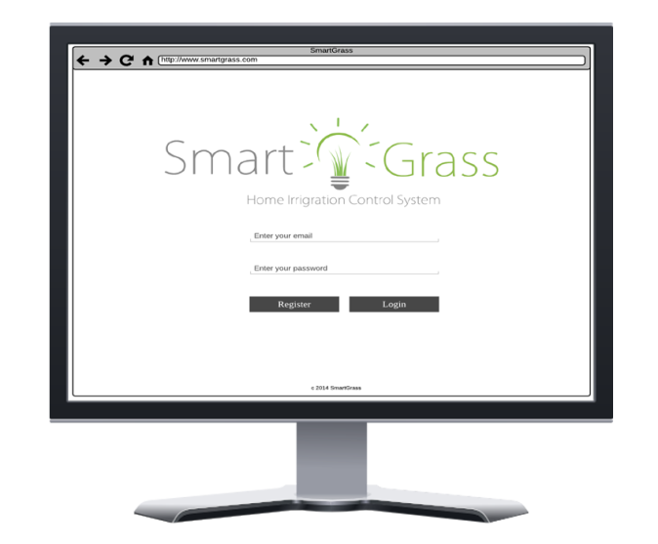
User Interface Requirements
User Login interface

Slide 19
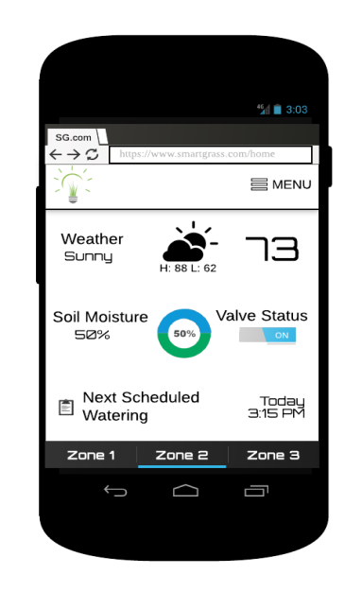
User Interface Requirements
Home Dashboard interface

Slide 20
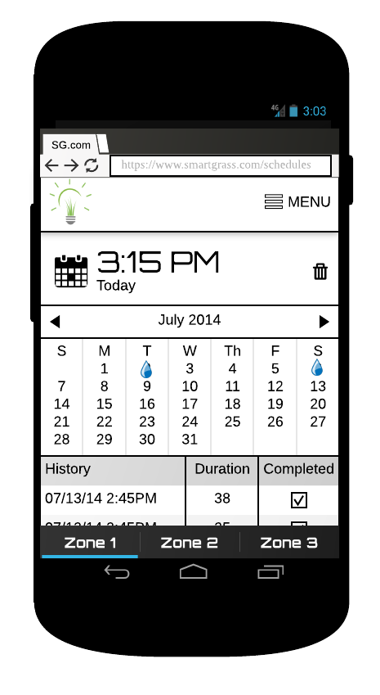
User Interface Requirements
Scheduler interface

Slide 21
Customer Requirements
5
Home Irrigation Control System
Jeremiah

Slide 22
Customer Requirements
What are the most critical functions of this products from a customer perspective?
3.1 Central Control Unit
3.1.1 - Description: The central control unit is responsible for all communication between the web application, soil moisture sensors, and water valves. The control unit will transmit the readings from the soil moisture sensors and report the data to the web application. The control unit also controls the water valves, which sets the flow of water to the sprinkler system.
3.1.2 - Source: Team SmartGrass
3.1.3 - Constraints: Wires from the water valves must be plugged into the control unit. The control unit also requires power from an outlet and must be connected to the internet.
3.1.4 - Standards: NEMA 5–15R power connector, cat5e Ethernet connector
3.1.5 - Priority: 1 – Critical Priority

Slide 23
Customer Requirements
What are the most critical functions of this products from a customer perspective?
3.2 Soil Moisture Sensors
3.2.1 - Description: In-ground sensors that monitor and report soil moisture levels.
3.2.2 - Source: Team SmartGrass
3.2.3 - Constraints: Must be connected directly to the central control unit and must be placed in the ground in close proximity to an irrigation zone.
3.2.4 - Standards: None
3.2.5 - Priority: 1 – Critical Priority

Slide 24
Customer Requirements
What are the most critical functions of this products from a customer perspective?
3.3 Web Application
3.3.1 - Description: The web application will be used to interface with the central control unit. The application is responsible for scheduling watering times as well as interfacing with the central control unit to control the water valves. The web application will be built with a scalable interface to enable the same functionality on a mobile device as it would on a desktop computer while maintaining a similar look and feel.
3.3.2 - Source: Team SmartGrass
3.3.3 - Constraints: Must be hosted on an online server and maintain a maximum uptime. Access to the application requires an internet connection and a supported web browser.
3.3.3 - Standards: None
3.3.5 – Priority: 1 – Critical Priority

Slide 25
Customer Requirements
What are the most critical functions of this products from a customer perspective?
3.4 Watering Scheduler
3.4.1 - Description: The web application can schedule watering times and durations for the sprinkler system. The scheduler will display upcoming watering schedules and allow users to create, edit, or delete them.
3.4.2 - Source: Team SmartGrass
3.4.3 - Constraints: None
3.4.4 - Standards: None
3.4.5 - Priority: 1 – Critical Priority

Slide 26
Customer Requirements
What are the most critical functions of this products from a customer perspective?
3.6 User Login
3.6.1 - Description: The user must login to the web application using the correct credentials to be able to remotely control features of HICS.
3.6.2 - Source: Team SmartGrass
3.6.3 - Constraints: The user must have an active internet connection and access to a supported web browser on their device. Additionally, a user account and correct credentials must be provided in order to login.
3.6.4 - Standards: None
3.6.5 - Priority: 1 – Critical Priority

Slide 27
Customer Requirements
What are the most critical functions of this products from a customer perspective?
3.7 Active Status
3.7.1 - Description: The web application will have a status indicator on the home dashboard to display whether a zone is actively being watered or not. (see Figure 2-4)
3.7.2 - Source: Team SmartGrass
3.7.3 - Constraints: None
3.7.4 - Standards: None
3.7.5 - Priority: 4 – Low Priority

Slide 28
Customer Requirements
What are the most critical functions of this products from a customer perspective?
3.8 Rain Sensor
3.8.1 - Description: An external rain sensor will monitor the weather conditions and will send an alert to the central control unit in the event of rain. The user preferences will dictate whether this event will turn the sprinklers off or not.
3.8.2 - Source: Nuts and Bolts Hardware
3.8.3 - Constraints: Rain sensor must be mounted outside and connected to the control unit.
3.8.4 - Standards: None
3.8.5 - Priority: 2 – High Priority

Slide 29
Customer Requirements
What are the most critical functions of this products from a customer perspective?
3.9 Web Hosting Server
3.9.1 - Description: There will be a server hosting our web application with an associated URL for domain user access.
3.9.2 - Source: Team SmartGrass
3.9.3 - Constraints: A subscription to a web hosting service must be acquired. A URL must also be registered and associated with the domain.
3.9.4 - Standards: None
3.9.5 - Priority: 1 – Critical Priority

Slide 30
Customer Requirements
What are the most critical functions of this products from a customer perspective?
3.10 Database Management System
3.10.1 - Description: There will be a DBMS that will store all data from soil sensor readings as well as all the information for the web application. This information includes user account information, settings, reports, and weather data necessary for the application to perform as expected.
3.10.2 - Source: Team SmartGrass
3.10.3 - Constraints: None
3.10.4 - Standards: None
3.10.5 - Priority: 1 – Critical Priority

Slide 31
Customer Requirements
What are the most critical functions of this products from a customer perspective?
3.11 Device Registration
3.11.1 - Description: A user must register their HICS device with their account in order to interface with it via the web application. The central control unit will have a unique serial number on it that will be used to register the device to a user account.
3.11.2 - Source: Team SmartGrass
3.11.3 - Constraints: The central control unit must have a valid serial number on it in order for a user to register the device.
3.11.4 - Standards: None
3.11.5 - Priority: 2 – High Priority

Slide 32
Customer Requirements
What are the most critical functions of this products from a customer perspective?
3.12 Region Grouping
3.12.1 - Description: A user may group their sprinkler zones into regions through the web application. This functionality will allow the user to setup watering schedules for multiple zones at once without having to configure each individual zone.
3.12.2 - Source: Nuts and Bolts Hardware
3.12.3 - Constraints: Each zone will have exactly one valve and each region must contain a minimum of one zone.
3.12.4 - Standards: None
3.12.5 - Priority: 3 – Moderate Priority

Slide 33
Customer Requirements
What are the most critical functions of this products from a customer perspective?
3.13 Auto Off
3.13.1 - Description: The user can set an auto off timer via the web application that terminates watering if the duration lasts longer than the set time.
3.13.2 - Source: Team SmartGrass
3.13.3 - Constraints: None
3.13.4 - Standards: None
3.13.5 - Priority: 3 – Moderate Priority

Slide 34
Package Requirements
6
Home Irrigation Control System
Billy

Slide 35
Packaging Requirements
What will be physically delivered to the customer?
4.1 Control Unit Housing
4.1.1 - Description: The components of the control unit, including its accessories, will be contained inside a mountable hard plastic container.
4.1.2 - Source: SmartGrass
4.1.3 - Constraints: This component needs to be wall mountable and must be packaged in a convenient form factor for the user
4.1.4 - Standards: None
4.1.5 - Priority: 1 – Critical Priority

Slide 36
Packaging Requirements
What will be physically delivered to the customer?
4.2 Soil Moisture Sensors Packaging
4.2.1 - Description: (4) Soil sensors will be included in the final packaging of HICS. They will be located within their own boxes and will have corresponding documentation that describes their proper installation. The user will be able to purchase additional soil moisture sensors and add them to their system.
4.2.2 - Source: Nuts and Bolts Hardware
4.2.3 - Constraints: The user will be responsible for the proper installation of the soil sensors according to the included instructions.
4.2.4 - Standards: None
4.2.5 - Priority: 3 – Moderate Priority

Slide 37
Packaging Requirements
What will be physically delivered to the customer?
4.3 Rain Sensor Packaging
4.3.1 - Description: (1) Rain sensor will be included in the final packaging of HICS. It will be located within its own box and will have corresponding documentation that describes its proper instillation.
4.3.2 - Source: Nuts and Bolts Hardware
4.3.3 - Constraints: The user will be responsible for the proper installation of the rain sensor according to the included instructions.
4.3.4 - Standards: None
4.3.5 - Priority: 3 – Moderate Priority

Slide 38
Packaging Requirements
What will be physically delivered to the customer?
4.4 Connecting Cables
4.4.1 - Description: (1) Power cable and (1) Ethernet cable will be included in the final packaging of HICS. Their intended purpose is to be used with the central control unit.
4.4.2 - Source: Team SmartGrass
4.4.3 - Constraints: None
4.4.4 - Standards: NEMA 5–15R power connector, cat5e Ethernet connector
4.4.5 - Priority: 3 – Moderate Priority

Slide 39
Packaging Requirements
What will be physically delivered to the customer?
4.5 Software Application
4.5.1 - Description: The HICS software should be a stand-alone web application that requires no set up from the user. The user must register an account with a valid product serial number to access the web application. Once they are logged into their account and their device has been connected, they will be able to access the features of the HICS.
4.5.2 - Source: Team SmartGrass
4.5.3 - Constraints: The user needs an active internet connection in order to interface with the web application. The central control unit must be connected to the internet via the included Ethernet cable and registered with the user’s account before it can be controlled.
4.5.4 - Standards: None
4.5.5 - Priority: 1 – Critical Priority

Slide 40
Packaging Requirements
What will be physically delivered to the customer?
4.6 User Manual
4.6.1 - Description: A user manual will be presented to the user that details the use and operation of HICS. It will be provided in the final packaging as a CD-ROM and will also be made available online via the web application.
4.6.2 - Source: Team SmartGrass
4.6.3 - Constraints: The manual will only be provided in English
4.6.4 - Standards: None
4.6.5 - Priority: 3 – Moderate

Slide 41
Performance Requirements
7
Home Irrigation Control System
Billy

Slide 42
Performance Requirements
How well the product response?
5.1 Sensor Accuracy
5.1.1 - Description: Proper sensor readings of soil moisture levels must be captured to ensure accurate and efficient watering schedules. This requires solid construction of the sensor modules and proper software analysis of the data provided by the sensors.
5.1.2 - Source: Team SmartGrass
5.1.3 - Constraints: Soil moisture sensors must be properly installed according to the provided instructions.
5.1.4 - Standards: None
5.1.5 - Priority: 2 – High Priority

Slide 43
Performance Requirements
How well the product response?
5.2 Rain Detection
5.2.1 - Description: In the event of rainy weather, the rain sensor must quickly transmit an alert to the control unit to interrupt or delay any active watering.
5.2.2 - Source: Team SmartGrass
5.2.3 - Constraints: The rain sensor must be properly placed and installed in order to ensure this functionality.
5.2.4 - Standards: None
5.2.5 - Priority: 3 – Moderate Priority

Slide 44
Performance Requirements
How well the product response?
5.3 Communication Between the Web Application and Central Control Unit
5.3.1 - Description: The user will be able to set watering schedules through the web application to send a signal to the central control unit to initiate watering. This must happen in a timely manner to ensure consistency between the scheduled start/end times and the actual start/end times.
5.3.2 - Source: Team SmartGrass
5.3.3 - Constraints: None
5.3.4 - Standards: None
5.3.5 - Priority: 2 – High Priority

Slide 45
Performance Requirements
How well the product response?
5.4 Communication Between the Soil Moisture Sensors and Central Control Unit
5.4.1 - Description: The soil moisture sensors will communicate with the central control unit to relay information about soil moisture levels. This must be accomplished periodically in an accurate and timely manner in order to avoid errors and to ensure consistency throughout the system.
5.4.2 - Source: Team SmartGrass
5.4.3 - Constraints: None
5.4.4 - Standards: None
5.4.5 - Priority: 2 – High Priority

Slide 46
Performance Requirements
How well the product response?
5.5 Device Power Malfunction
5.5.1 - Description: If the server fails to receive communication from the central control unit for a specified period of time, it will notify the user that the system is offline.
5.5.2 - Source: Nuts and Bolts Hardware
5.5.3 - Constraints: Control unit must be without power for a specified period of time.
5.5.4 - Standards: None
5.5.5 - Priority: 3 – Moderate Priority

Slide 47
Safety Requirements
8
Home Irrigation Control System
Gautam

Slide 48
Safety Requirements
How safe is the product?
6.1 Soil Moisture Sensor Insulation
6.1.1 - Description: The electronic components of the soil moisture sensors must be properly insulated against external environmental conditions. This is to ensure that they do not malfunction while in use.
6.1.2 - Source: Team SmartGrass
6.1.3 - Constraints: None
6.1.4 - Standards: None
6.1.5 - Priority: 2 – High Priority

Slide 49
Safety Requirements
How safe is the product?
6.2 Central Control Unit Temperature
6.2.1 - Description: Efficient air flow and low temperatures must be established while the central control unit is in operation. Computer fans and proper ventilation in the housing container will be used to cool the device and prevent it from overheating and possibly starting a fire.
6.2.2 - Source: Team SmartGrass
6.2.3 - Constraints: None
6.2.4 - Standards: None
6.2.5 - Priority: 2 – High Priority

Slide 50
Safety Requirements
How safe is the product?
6.3 Proper Wiring of Central Control Unit
6.3.1 - Description: The central control unit will be powered from an external wall plug. The source will be 120v and improper wiring could leave the user exposed to currents in the range of 15-20 amps. It is crucial that the control unit is wired properly to accept this input and cause no harm to the device or the user.
6.3.2 – Source: Team SmartGrass
6.3.3 - Constraints: None
6.3.4 - Standards: NEMA 5–15R power connector
6.3.5 - Priority: 1 – Critical Priority

Slide 51
Maintenance and Support Requirements
9
Home Irrigation Control System
Gautam

Slide 52
Maintenance and Support Requirements
How will the product be maintained and supported?
7.1 Sensor Maintenance
7.1.1 - Description: The soil and rain sensors will be replaceable in the event of hardware failure.
7.1.2 - Source: Nuts and Bolts Hardware
7.1.3 - Constraints: Replacement sensor must be compatible with the device.
7.1.4 - Standards: None
7.1.5 - Priority: 2 – High Priority

Slide 53
Maintenance and Support Requirements
How will the product be maintained and supported?
7.2 Software Maintenance
7.2.1 - Description: All source code files and relevant documentation must be available for software maintenance and troubleshooting. The required files and documentation will be available via the GitHub repository. The software will be split into loosely coupled parts so it would be easier to make changes and improvements to the system over time.
7.2.2 - Source: Team SmartGrass
7.2.3 - Constraints: None
7.2.4 - Standards: None
7.2.5 - Priority: 3 – Moderate Priority

Slide 54
Maintenance and Support Requirements
How will the product be maintained and supported?
7.3 Source Code Documentation
7.3.1 - Description: All source code files required for HICS will be extensively commented to support future updates and troubleshooting.
7.3.2 - Source: Team SmartGrass
7.3.3 - Constraints: None
7.3.4 - Standards: None
7.3.5 - Priority: 3 – Moderate Priority

Slide 55
Maintenance and Support Requirements
How will the product be maintained and supported?
7.4 Scalability
7.4.1 - Description: The central control unit will support adding additional valves or soil sensors.
7.4.2 - Source: SmartGrass
7.4.3 - Constraints: The central control unit will support up to thirty-two valves and thirty-two corresponding soil sensors.
7.4.4 - Standards: None
7.4.5 - Priority: 2 – High Priority

Slide 56
Other Requirements
10
Home Irrigation Control System
Gautam

Slide 57
Other Requirements
8.1 Mapping the Soil Moisture Sensors to Irrigation Valves
8.1.1 - Description: HICS requires that the user properly maps the soil moisture sensors to the irrigation valves. The central control unit will feature a diagram showing the one-to-one relationship between soil moisture sensor inputs and irrigation valve inputs.
8.1.2 - Source: Team SmartGrass
8.1.3 - Constraints: The user must follow the included diagram and instructions to properly map the sensors and valves.
8.1.4 - Standards: None
8.1.5 - Priority: 1 – Critical Priority

Slide 58
Other Requirements
8.2 Browser Support
8.2.1 - Description: The web application should be scalable and responsive in all of the latest versions of Mozilla Firefox, Google Chrome, and Internet Explorer.
8.2.2 - Source: Team SmartGrass
8.2.3 - Constraints: Versions of Internet Explorer older than IE9.0 will not be supported. Browsers other than the ones listed above may not necessarily be supported.
8.2.4 - Standards: None
8.2.5 - Priority: 3 – Moderate Priority

Slide 59
Other Requirements
8.3 Central Control Unit Mounting
8.3.1 - Description: The central control unit must be mounted in a location where it can interface with wires from the water valves and soil moisture sensors. It must also be within range of Ethernet and power outlets.
8.3.2 - Source: Team SmartGrass
8.3.3 - Constraints: Mounting location must be within range of Ethernet and power outlets.
8.3.4 - Standards: None
8.3.5 - Priority: 2 – High Priority

Slide 60
Other Requirements
8.4 Rain Sensor Mounting
8.4.1 - Description: The rain sensor must be placed outdoors in a location where there are no obstructions directly above it. The best placement for this sensor is on the roof of the user’s home in a location where other water sources will not interfere with it.
8.4.2 - Source: Team SmartGrass
8.4.3 - Constraints: Rain sensor must be mounted in a location free from obstructions and must be properly connected to the central control unit.
8.4.4 - Standards: None
8.4.5 - Priority: 3 – Moderate Priority

Slide 61
Other Requirements
8.5 Application Security and Privacy
8.5.1 - Description: All user data and account information will be stored on a secure server. Users will only be allowed to access their HICS devices and account information if they provide the correct login credentials. In addition, all user passwords will be encrypted and stored only as hash values.
8.5.2 - Source: Team SmartGrass
8.5.3 - Constraints: User passwords are required to be six characters in length and contain one upper case and numerical character.
8.5.4 - Standards: OWASP Web Application Security Standards
8.5.5 - Priority: 3 – Moderate Priority

Slide 62
Other Requirements
8.6 User Administration Account
8.6.1 - Description: The web application will allow for administrative accounts to create, edit, and delete user accounts and their associated devices.
8.6.2 - Source: Team SmartGrass
8.6.3 - Constraints: None
8.6.4 - Standards: None
8.6.5 - Priority: 2 – High Priority

Slide 63
Acceptance Criteria
11
Home Irrigation Control System
Gautam

Slide 64
Acceptance Criteria
9.2.1 - Requirement(s) addressed:
9.2.2 - Verification Procedure: After the user successfully logs in, they are directed to the home dashboard screen (see Figure 2-4). The user will tap/click the “On/Off” toggle under the heading “Valve Status” to toggle the water for that zone on and off.
Requirement Number | Name
3.1 | Central Control Unit
3.3 | Web Application

Slide 65
Acceptance Criteria
9.3.1 - Requirement(s) addressed:
9.3.2 - Verification Procedure: The soil sensors will provide the user with the details regarding the moisture conditions of their soil. Once the user is successfully logged in they will be redirected to the home dashboard screen (see Figure 2-4) where they can view the soil moisture levels for each zone in their lawn.
Requirement Number | Name
3.1 | Central Control Unit
3.2 | Soil Moisture Sensors
3.3 | Web Application
3.5 | Soil Moisture Reports

Slide 66
Acceptance Criteria
9.4.1 - Requirement(s) addressed:
9.4.2 - Verification Procedure: If the rain sensor detects rainfall it will signal the central control unit to close all watering valves. To verify the user can turn on watering in a zone (see Section 9.2) and pour water into the rain sensor to trigger a watering stoppage.
Requirement Number | Name
3.1 | Central Control Unit
3.8 | Rain Sensor

Slide 67
Acceptance Criteria
9.5.1 - Requirement(s) addressed:
9.5.2 - Verification Procedure: Each valve will have a soil sensor that detects the moisture of that zone. The user can water any individual zone or region any time via the web application (see section 9.2). Users will have the ability to create “Regions” which are groups of zones. For example the user could group all zones where the valves lead to backyard and they could define that region as “backyard”. This allows users to control watering for multiple zones by regions.
Requirement Number | Name
3.1 | Central Control Unit
3.2 | Soil Moisture Sensors
3.3 | Web Application
3.10 | Database Management System
3.12 | Region Grouping

Slide 68
Acceptance Criteria
9.5.1 - Requirement(s) addressed:
9.6.2 - Verification Procedure: Users have the option of scheduling watering time instead of manually toggling their sprinkler system as seen in section 9.2. To create or modify a schedule the user must successfully login to the application and navigate to the schedules page (see Figure 2-5). From the schedules page users can create, edit, or delete watering schedules for each zone. This page also provides the user with past watering events and displays their duration and completion. To verify a watering schedule the user must create a schedule by clicking on the calendar icon seen in Figure 2-5. They must then select a date and time for watering and select whether the event should reoccur. Once a time has been scheduled they must simple visit to scheduled zones during their watering time and observed the activity.
Requirement Number | Name
3.1 | Central Control Unit
3.3 | Web Application
3.10 | Database Management System

Slide 69
Acceptance Criteria
9.5.1 - Requirement(s) addressed:
9.6.2 - Verification Procedure: Users have the option of scheduling watering time instead of manually toggling their sprinkler system as seen in section 9.2. To create or modify a schedule the user must successfully login to the application and navigate to the schedules page (see Figure 2-5). From the schedules page users can create, edit, or delete watering schedules for each zone. This page also provides the user with past watering events and displays their duration and completion. To verify a watering schedule the user must create a schedule by clicking on the calendar icon seen in Figure 2-5. They must then select a date and time for watering and select whether the event should reoccur. Once a time has been scheduled they must simple visit to scheduled zones during their watering time and observed the activity.
Requirement Number | Name
3.1 | Central Control Unit
3.3 | Web Application
3.10 | Database Management System

Slide 70
Use Cases
12
Home Irrigation Control System
Billy

Slide 71
Use Cases
8.1. Registration Device - Web Application Based
User will access a website via a given link to register the product. The user will be taken to a screen to register the product. User will be asked to input serial number of product.
8.2. Create User Account - Web Application Based
After validation of the HICS product that user purchases, the user will be allowed to create an account to check the status of HICS product installed at the user's house.

Slide 72
Use Cases
8.3. User Sign In - Web Application Based
At the login screen, user will enter his username and password. There will be an option to let the browser to cache user's credentials for the next use.
8.4. Check Status of HICS - Web Application Based
After logging in successfully, the user will be taken to page of the dashboard of the user's home irrigation

Slide 73
Use Cases
8.5. Turn On/Off Water Valves - Web Application Based
From this status page, there is a button that allows user turn on or turns off the water valves of his home irrigation.
8.6. Check Watering Log - Web Application Based
From this dashboard, there is a link that takes the user to the page showing the watering history of his home irrigation

Slide 74
Use Cases
8.7. Schedule Watering - Web Application Based
From the dashboard, there is a link that takes the user to the page that let user set the schedule for his home irrigation.

Slide 75
Use Cases
Valve Control Diagram

Slide 76
Use Cases
User Control Diagram

Slide 77
Use Cases
User Control Diagram

Slide 78
Use Cases
Check Status Diagram

Slide 79
Use Cases
Check Status Diagram

Slide 80
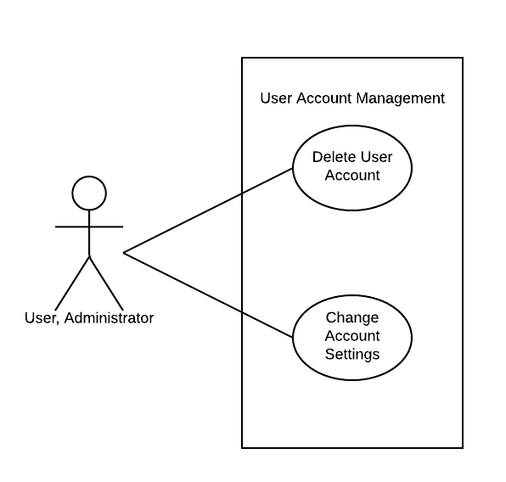
Use Cases
Account Management Diagram

Slide 81
Feasibility Assessment
13
Home Irrigation Control System
Jeremiah

Slide 82
Feasibility Assessment
11.1 Scope Analysis
The overall scope of HICS has been examined and discussed by all team members and has been determined to be reasonable given the project deadline. After examining the requirements with the highest priorities we determined the majority of the work will be with the web application. Our team has 2 members that have had years of real world experience developing large scale web applications for companies so the outlook for the web application work schedule is very feasible.
Research on the hardware components of HICS has also provided our team with a positive outlook for the scope. This assessment is based on our research of each individual components and our team’s technical background with each of them. While we have a few team members who have great experience in microcontrollers our concern is with the interaction between the sensors and microcontroller. This assessment is based on the lack of knowledge and experience with soil sensors. This initial assessment is based purely off the research we have done regarding the sensors and the processes of gathering readings as data. In conclusion after analyzing the requirements and prioritizing them based off importance we have evaluated that the project is within scope and the probability of completion before the deadline is high.

Slide 83
Feasibility Assessment
11.2 Research
Our primary focus on research has been the components we are unfamiliar with. Our team has been researching different soil sensors to determine which will be the best fit for HICS. This research has been evaluated and compared to the other hardware components that will interface with the sensors. We have reviewed tutorials and other projects online to study how the interactions between the sensors and controller take place. This research has aided us in deciding which microcontroller is optimal for the project and our budget.
The information we lack in home irrigation has been another primary focus of our research. Fortunately our sponsor is very knowledgeable and has even provided us with a resource that runs water conservation for the City of Arlington. He has been extremely helpful in gathering information for our team to research and has provided us with multiple resources to help minimize the learning curve.

Slide 84
Feasibility Assessment
11.3 Technical Analysis
A thorough technical analysis has been a priority task for our team. We determined before purchasing or finalizing any components we first needed to examine what our technical strengths and weaknesses were.
While no one on the team has had any experience with home irrigation systems we all have had experience with the majority of the individual components that it consists of. The primary hardware components are the control unit, soil sensors, and water valve system. We have carefully diagramed and examined each piece of hardware to determine how they will interact and function together. We have determined that the microcontroller is the component that our team is most familiar with. We have two team members who have had extensive work with microcontrollers primarily Arduino and Raspberry Pi. This experience will enable our team to focus our hardware research for the sensors and water valve system. The control unit will consist of a microcontroller that will be connected to each water valve and will also be responsible for powering the soil sensors. All three of these components will be controlled by the web application/server.
Our team has examined the requirements needed for the web application and our outlook is very positive. We have two members of the team who have worked for major corporations in industry developing very large scale web applications for clients. Their skills in this facet will provide great insight into the development and design of our web application. Their experience with the SDLC will also ensure a smooth transition from conception to prototype.

Slide 85
Feasibility Assessment
11.3 Technical Analysis
A thorough technical analysis has been a priority task for our team. We determined before purchasing or finalizing any components we first needed to examine what our technical strengths and weaknesses were.
While no one on the team has had any experience with home irrigation systems we all have had experience with the majority of the individual components that it consists of. The primary hardware components are the control unit, soil sensors, and water valve system. We have carefully diagramed and examined each piece of hardware to determine how they will interact and function together. We have determined that the microcontroller is the component that our team is most familiar with. We have two team members who have had extensive work with microcontrollers primarily Arduino and Raspberry Pi. This experience will enable our team to focus our hardware research for the sensors and water valve system. The control unit will consist of a microcontroller that will be connected to each water valve and will also be responsible for powering the soil sensors. All three of these components will be controlled by the web application/server.
Our team has examined the requirements needed for the web application and our outlook is very positive. We have two members of the team who have worked for major corporations in industry developing very large scale web applications for clients. Their skills in this facet will provide great insight into the development and design of our web application. Their experience with the SDLC will also ensure a smooth transition from conception to prototype.

Slide 86
Future Items
14
Home Irrigation Control System
Tung

Slide 87
Future Items
12.1 Wireless Sensors Network
12.1.1 - Description: Soil moisture sensors could be upgraded to wireless sensors to streamline communication to the central control unit. A wireless sensor network would increase the flexibility in sensor placement and make the installation of the sensors much easier.
12.1.2 - Source: Nuts and Bolts Hardware
12.1.3 - Constraints: Wireless sensors require a wireless power source which limits the sensors lifespan. Replaceable or rechargeable batteries would be needed to ensure the sensors can maximize their uptime.

Slide 88
Future Items
12.2 Standalone Mobile Application
12.2.1 - Description: The HICS web application is designed to scale to size for users accessing it via a mobile device. A standalone mobile application that is developed separately from the web application would be a more polished alternative to this approach for mobile users.
12.2.2 - Source: Team SmartGrass
12.2.3 - Constraints: Creating a separate mobile application would take valuable time and resources away from the core development of this project. In addition, publishing a mobile application would cut into our budget as there is often a fee associated with it.

Slide 89
Future Items
12.3 Upcoming Weather Alerts
12.3.1 - Description: The HICS utilizes rain sensors to avoid watering during rainy weather. However, this method is only useful when it is actually raining. A weather alert feature could pull reports from local weather APIs and alert the user if a scheduled watering event conflicts with upcoming rainy weather.
12.3.2 - Source: Team SmartGrass
12.3.3 - Constraints: Weather reports would have to be very accurate to the location of the central control unit

Slide 90
Question?
?
Home Irrigation Control System

